Slide 1
Propositional Logic
CSI 219 – Discrete Mathematics
Course teacher: Minhajul Bashir

Slide 2
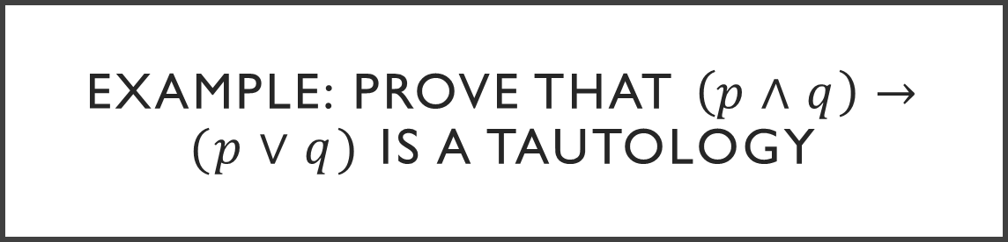
Example: Prove that $\left(p∧q\right)→(p∨q)$ is a tautology
Rosen, page 27, example 8

Slide 3
… wait, what??

Slide 4
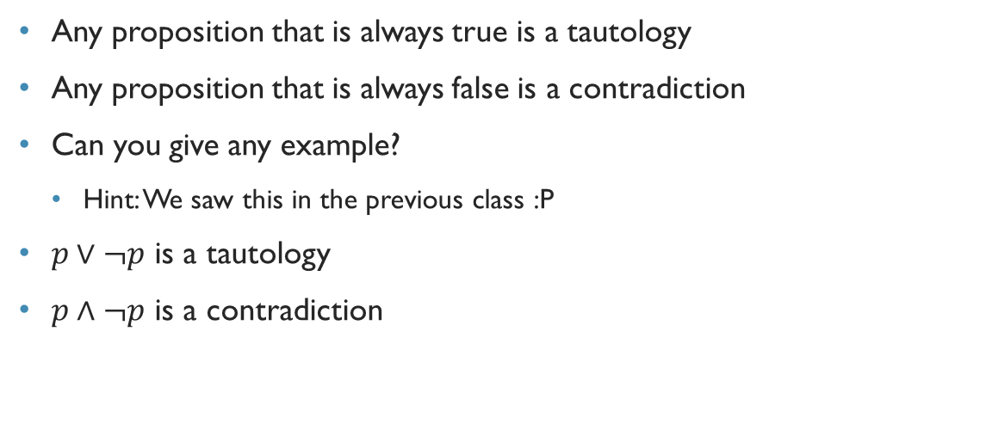
Tautology and contradiction
Any proposition that is always true is a tautology
Any proposition that is always false is a contradiction
Can you give any example?
Hint: We saw this in the previous class :P
$p∨¬p$ is a tautology
$p∧¬p$ is a contradiction

Slide 5

Formal definition of equivalence
The compound propositions $p$ and $q$ are logically equivalent, i.e. $p≡q$, if $p↔q$ is a tautology.

Slide 6
Example: Prove that $\left(p∧q\right)→(p∨q)$ is a tautology
Rosen, page 27, example 8

Slide 7
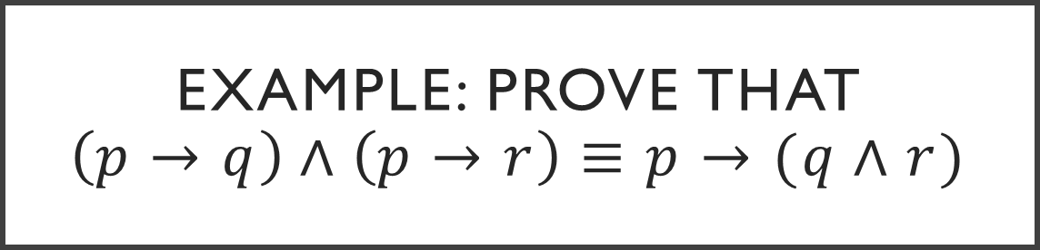
Example: Prove that $\left(p→q\right)∧\left(p→r\right)≡p→(q∧r)$
Rosen, page 29, exercise 22

Slide 8
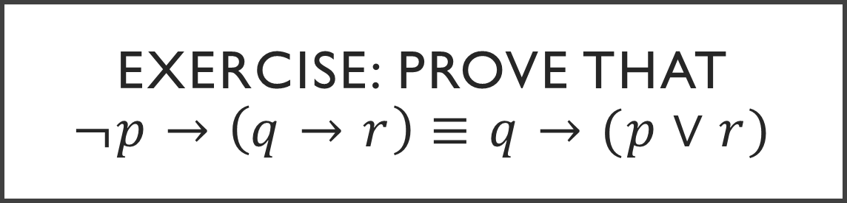
Exercise: Prove that $¬p→\left(q→r\right)≡q→(p∨r)$
Rosen, page 29, exercise 26

Slide 9

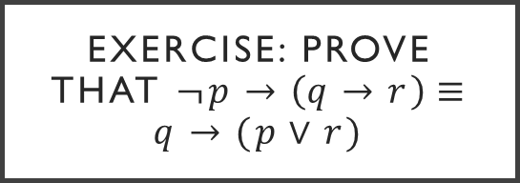
Exercise: Prove that $¬p→\left(q→r\right)≡q→(p∨r)$
$¬p→\left(q→r\right)$
$≡¬\left(¬p\right)∨(q→r)$
$≡p∨(q→r)$
$≡p∨(¬q∨r)$
$≡p∨¬q∨r$
$≡¬q∨p∨r$
$≡¬q∨(p∨r)$
$≡q→(p∨r)$
Rosen, page 29, exercise 26

Slide 10
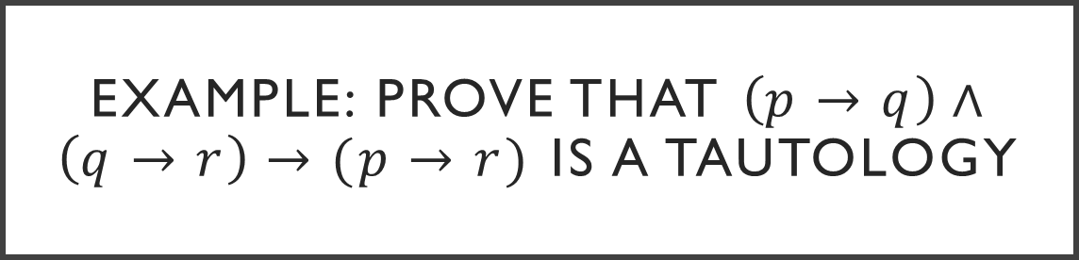
Example: Prove that $\left(p→q\right)∧\left(q→r\right)→(p→r)$ is a tautology
Rosen, page 29, exercise 29

Slide 11
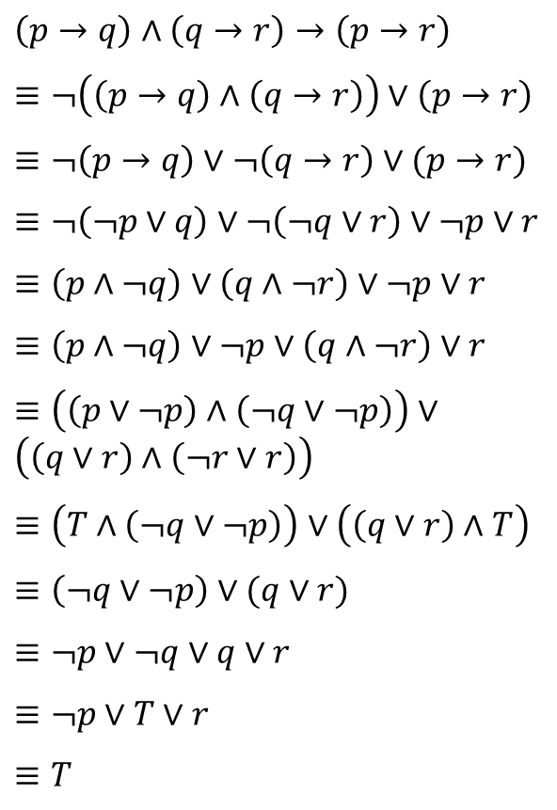
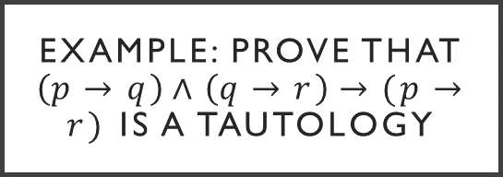
Example: Prove that $\left(p→q\right)∧\left(q→r\right)→(p→r)$ is a tautology
$\left(p→q\right)∧\left(q→r\right)→\left(p→r\right)$
$≡¬\left(\left(p→q\right)∧\left(q→r\right)\right)∨\left(p→r\right)$
$≡¬\left(p→q\right)∨¬\left(q→r\right)∨(p→r)$
$≡¬\left(¬p∨q\right)∨¬\left(¬q∨r\right)∨¬p∨r$
$≡\left(p∧¬q\right)∨\left(q∧¬r\right)∨¬p∨r$
$≡\left(p∧¬q\right)∨¬p∨\left(q∧¬r\right)∨r$
$≡\left(\left(p∨¬p\right)∧\left(¬q∨¬p\right)\right)∨\left(\left(q∨r\right)∧\left(¬r∨r\right)\right)$
$≡\left(T∧\left(¬q∨¬p\right)\right)∨\left(\left(q∨r\right)∧T\right)$
$≡\left(¬q∨¬p\right)∨(q∨r)$
$≡¬p∨¬q∨q∨r$
$≡¬p∨T∨r$
$≡T$
Rosen, page 29, exercise 29

Slide 12

Exercise: Prove that $¬\left(p↔q\right)≡p↔¬q$
Rosen, page 28, exercise 16

Slide 13
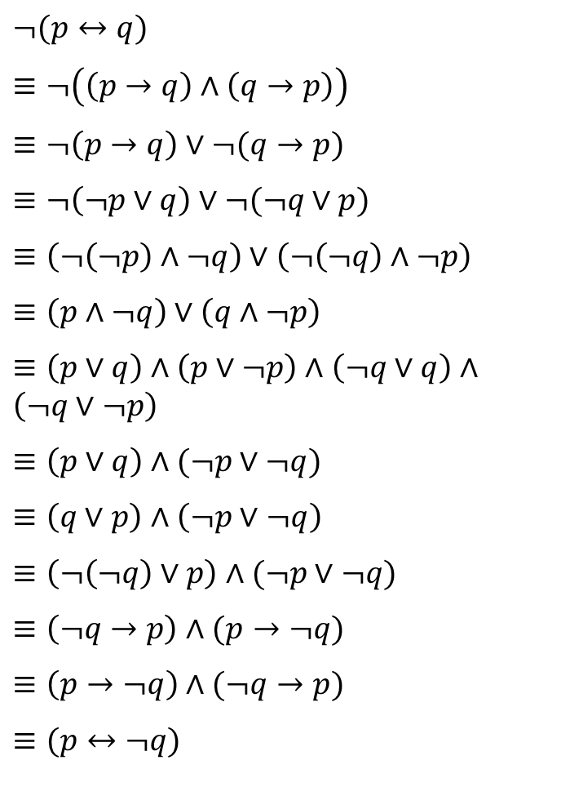
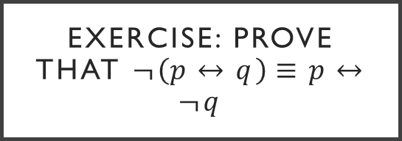
Exercise: Prove that $¬\left(p↔q\right)≡p↔¬q$
$¬(p↔q)$
$≡¬\left(\left(p→q\right)∧\left(q→p\right)\right)$
$≡¬\left(p→q\right)∨¬(q→p)$
$≡¬\left(¬p∨q\right)∨¬(¬q∨p)$
$≡\left(¬\left(¬p\right)∧¬q\right)∨\left(¬\left(¬q\right)∧¬p\right)$
$≡\left(p∧¬q\right)∨\left(q∧¬p\right)$
$≡\left(p∨q\right)∧\left(p∨¬p\right)∧\left(¬q∨q\right)∧\left(¬q∨¬p\right)$
$≡\left(p∨q\right)∧(¬p∨¬q)$
$≡\left(q∨p\right)∧\left(¬p∨¬q\right)$
$≡\left(¬\left(¬q\right)∨p\right)∧(¬p∨¬q)$
$≡\left(¬q→p\right)∧(p→¬q)$
$≡\left(p→¬q\right)∧(¬q→p)$
$≡(p↔¬q)$
Rosen, page 28, exercise 16

Slide 14
Announcement – Assignment 1
Solve problems 21 – 30 from Rosen, page 29
You MUST use equivalence laws for solving the problems
Don’t worry about getting the correct answers – your efforts will be evaluated for this assignment ☺
In a cover sheet, write down your name, student ID, course code, section and course teacher’s name. Attach the cover sheet with the assignment.
Submission deadline: Wednesday, June 14
Late submission will NOT be allowed without prior consent and valid reason

Slide 15
Announcement – Class Test 1
Wednesday, June 14
Syllabus: Propositional logic and equivalences
Rosen section 1.1 and 1.2
Problem types: translating English sentences to propositions and vice versa; finding out conerse, contrapositive and inverse for English sentence; truth tables; proof of equivalence using truth table and equivalence laws

